Slide 1
Using an API
Hy-Tech Club: Web 103
Notes:
Now let’s dive into how you can actually use an API in JavaScript.

Slide 2
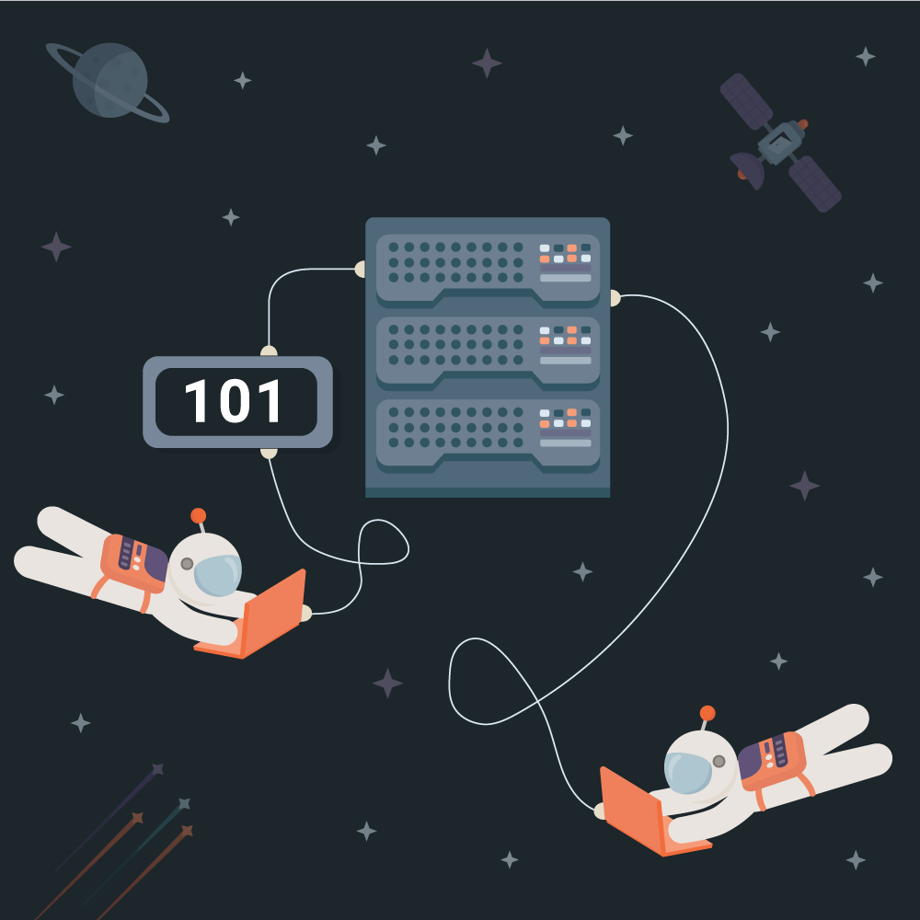
Agenda
Finding an API
fetch
async / await
try / catch
Notes:
Here is what we will cover.

Slide 3

Finding an API: Exploration
The internet is vast and terrifying...
There is an API for almost anything...
Public APIs
Notes:
The first step to using an API is finding a good one! You can explore online and find some very interesting things.
The internet is vast and terrifying…
You can probably find an API for pretty much anything just by googling.
There is a big list of public APIs that’s a good starting point too!

Slide 4
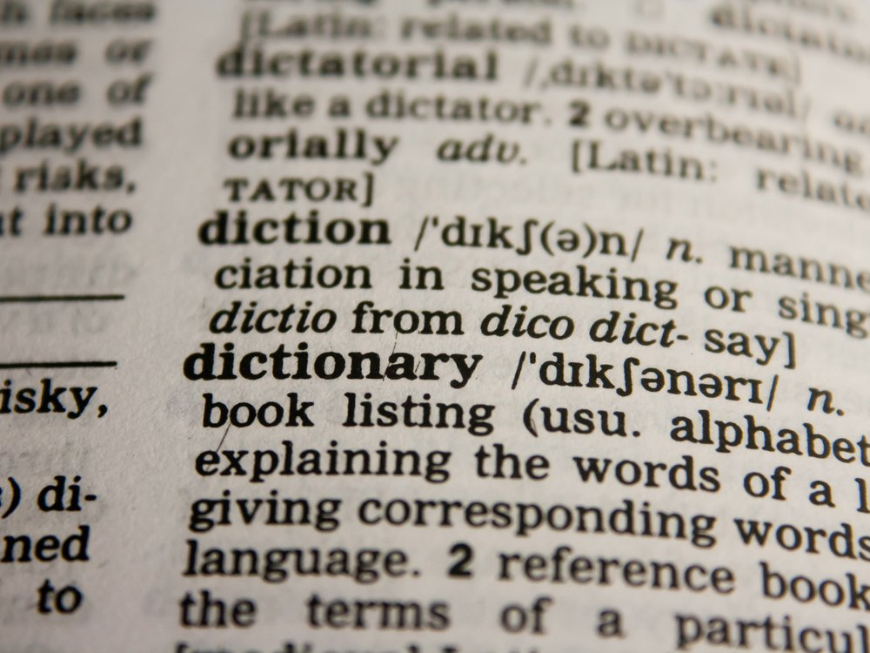
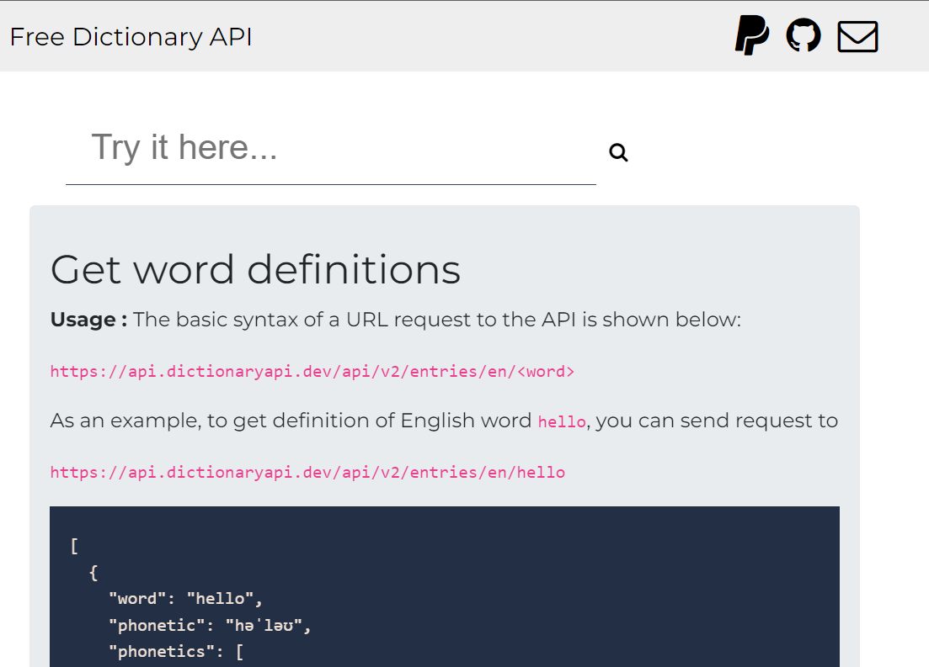
API Example: Dictionary
https://dictionaryapi.dev/
Notes:
For this lecture, let’s take a look at a basic example: a dictionary API.
It’s a dictionary – so you give it a word, and it gives you the definition.
Going to this page looks something like this – the API documentation shows exactly how to use it! It gives an example for a word, and shows what will be returned.

Slide 5
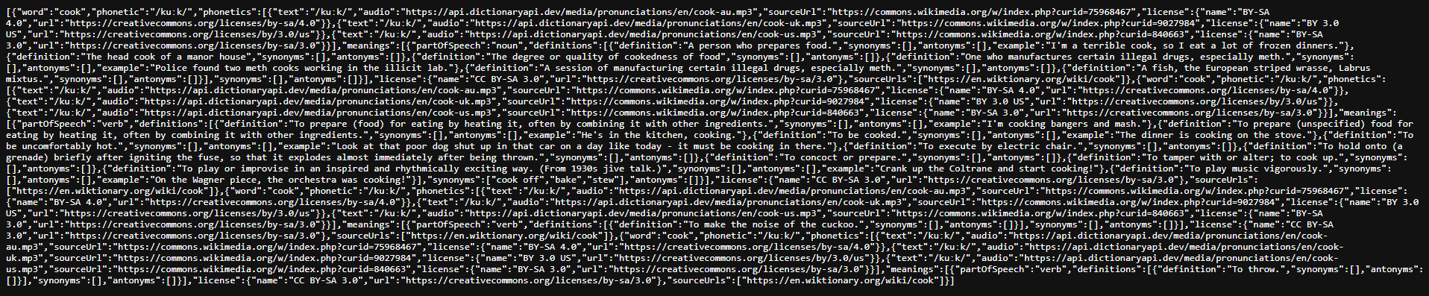
Dictionary Response
https://api.dictionaryapi.dev/api/v2/entries/en/cook
JSON
What type of data is this?
Notes:
So let’s take a look at an example. Say we look up the word “cook” through this URL.
What comes back is a gigantic block of text.
Can anyone guess what type of data this is?
It’s JSON data! That means we can parse it and use it in our JavaScript code!

Slide 6
JSON → Information
let response = [{
"word": "cook",
"partOfSpeech": "noun",
"definition": "A person who prepares food.",
"audio": "cook-au.mp3"
}, {
"word": "cook",
"partOfSpeech": "verb",
"definition": "To prepare food for eating."
}];
Data (Simplified)
response[0].audio
response[1].definition
Get the audio for the first word in the array
Get the definition for the second word in the array
Notes:
Once that URL has been found, the next step will be to take the JSON object and turn it into information.
Skipping some steps that we will cover later, let’s say the data comes back like this – an array of objects, each with different properties.
How could I get the audio for the first word in the array?
It looks like this: response sub zero dot audio.
Okay, let’s try another: How could I get the definition for the second word in the array?
It looks like this: response sub one dot definition. If you want to use data from an API, it will be super important to be able to read the response, and know how to grab what you want from it.

Slide 7
https://jsfiddle.net/uhb6e2fy/
Notes:
Let’s take a look at a website that actually uses the Dictionary API to return one definition. Try to enter some different words to see what it says!

Slide 8
REQUESTS IN Code
fetch | async/await | try/catch
Notes:
So, you have an API, and you want to get data from it. We’re now going to talk about how to actually make the request from JavaScript.

Slide 9
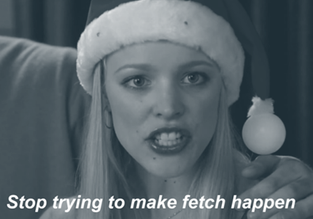
The fetch Function
The fetch function sends a network request to a given URL
The URL is passed as a parameter to the function when called
It is asynchronous, meaning it returns a Promise object
Notes:
The key to this is the fetch function.
This function sends a network requests to a given URL.
The URL is passed as a parameter to the function when called.
The fetch function is asynchronous, meaning it returns a promise.

Slide 10

fetch Example
Basic Example
let myFruitPromise = fetch("https://food.com?name=pineapple");
Dynamic Example
let fruit = prompt("Fruit");
fetch(`https://food.com/?name=${fruit}`);
But how can the code deal with the myFruitPromise object?
Notes:
Let’s see an example.
In this basic example, we have a call to fetch that goes to this URL. The resulting object is stored in the myFruitPromise variable. This will likely be some sort of data about a pineapple. But what if we wanted the user to tell us which fruit they wanted?
In this dynamic example, the first step is to prompt the user for a fruit. That fruit is then inserted into the URL through an interpolation!
So, fetch is just a function that takes a URL… but what does it return? How can we deal with the Promise object?

Slide 11
Handling Promises with await
let url = `https://food.com?name=tofu`;
let myResponse = await fetch(url);
Simply place the await keyword in front of a Promise object to yield the returned value
Execution within the code block will continue when the task is completed
🤔 🤔 🤔
But... isn’t the whole point to avoid waiting?
Yes! But because the call is asynchronous, other parts of the code continue to execute while this block waits!
Notes:
Promises are really weird, but luckily, there is a relatively simple way to deal with them. You may think that in this example, the myResponse variable would hold a Promise… but it actually does not! Because of the await keyword, the myResponse variable holds an actual response object.
You just have to put the await keyword in front of any promise object, and it will give you the result of the Promise when it’s done.
The code block will wait for the promise to resolve before it continues!
Now you might be thinking… wait… isn’t the whole point to avoid waiting around for code to complete?
The answer is yes! But through the magic of asynchronicity, the rest of the program can continue responding while this one specific block waits for the promise response. It’s very cool and wow!

Slide 12

Defining Functions with async
async function grabData(url) {
let result = await fetch(url);
let json = await result.json();
return json;
}
Simply place the async keyword in front of a function definition to make it asynchronous
await only works in async functions!
Notes:
Speaking of blocks, does anyone know what a block is? It’s anything in between curly brackets, like the body of a function, or the body of an if statement. The key to using await is that it needs an asynchronous block, like this one!
Use the async keyword in front of any function definition to make it asynchronous.
It is very important to know that you can’t use the await keyword unless you’re inside an async function!

Slide 13
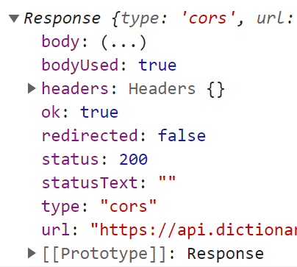
Dealing with Response Objects
Responses contain a ton of information...
The json() Function
The json function on a Response returns a Promise that yields the response body data
let parsedObject =
await response.json();
The parsedObject variable contains the actual data as a JavaScript object
Notes:
So we got our asynchronous stuff all working and good, and our fetch gives us a Response object. What’s next?
Responses returned by fetch actually have a ton of information, and the data itself is not immediately available.
They look something like this – lots of different properties…
But the body of the response is what we want, and it’s not there yet!
That’s where the json function enters the picture. This can be called on a Response object, and it returns a promise that will yield the actual data in the body of the response. Since it returns a promise, what keyword should we put in front of it?
It should look like this! The await keyword is used once again.
Now, the parsedObject variable contains the actual data. We are almost ready to start using it… but not quite…

Slide 14
Handling Errors Gracefully
But what if something goes wrong???
Should we immediately destroy the entire page???
No!
Luckily, there is a way for a script to try running some code, and respond appropriately if the code fails for some reason.
This is possible with the try / catch construct.
Notes:
One thing we need to consider when dealing with APIs is that there may be errors.
What if something goes wrong?
Should everything blow up??
No! Probably not!
Luckily, there’s a way to try running code without destroying everything if it fails.
We can use try catch to make this happen.

Slide 15
Kind of like an if statement
try {
// code...
} catch (err) {
// error handling
}
err object contains information about what went wrong
Notes:
The try catch structure looks like this!
It might remind you of an if statement – the code to run is in the try block, and the error handling takes place in the catch block.
In the catch, the err object contains information about what went wrong, such as an error message. This helps the code properly handle whatever may have happened!

Slide 16
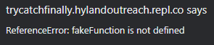
try / catch Example
Function that does not exist
try {
fakeFunction();
} catch (err) {
alert(err);
}
Notes:
Here’s an example.
Here, the fakeFunction function does not actually exist. What do you think will happen?
Well, when the code runs, it will catch that error, and it will display a pop-up saying “fakeFunction is not defined”! This is much easier to see than something failing silently, and everything not working for seemingly no reason. It will come in handy a lot when dealing with APIs.

Slide 17
finally
It is also possible to run one block of code after the try catch, immediately before the end. This will run whether the code fails or succeeds.
try {
// code...
} catch (err) {
// error handling
} finally {
// will always run!
}
Notes:
One last piece of the structure is the finally block.
The code in this block will run no matter what – after the try and/or catch code runs. It runs right at the end, and can be a good place to clean things up.
It looks like this – right at the end, after the catch.

Slide 18
https://jsfiddle.net/zkwp58xy/
Notes:
Walk through code in the example.

Slide 19
Putting It All Together
Do research on an API, and find a URL
Call the fetch function on that URL
Use await in front of the fetch call
Make sure the containing function is async
Use the json() function on the Response object
Again, using await in front of the call
Wrap the whole thing in a try/catch
Make sure to declare variables above
Use the JSON data to do something!
Notes:
Now let’s recap everything!
To start, do research on an API, and find a URL.
When you have the URL, call the fetch function on it,
Use await in front of the fetch call though, and make sure the containing function is async.
When you get a Response, use the json() function on the object. Again, using await in front of the call.
Wrap the whole thing in a try/catch, and make sure to declare variables above.
Finally, use the JSON data to do something!

Slide 20
https://jsfiddle.net/wtenm5d0/
Notes:
Walk through code in the example.

Slide 21
THE END
Questions?
Notes:
I assume there are no questions.

